Slide 1
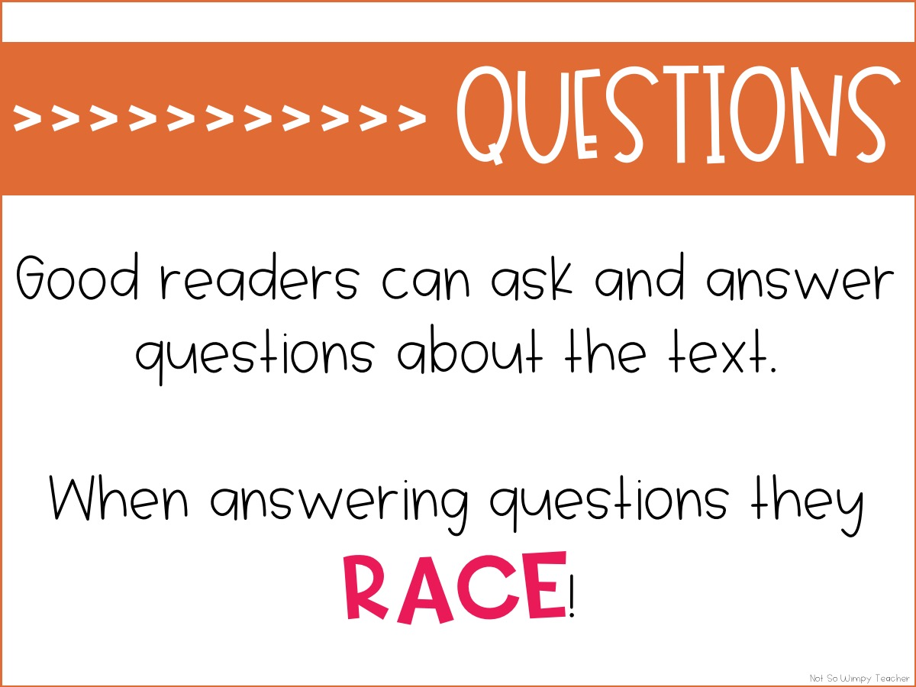

Slide 2
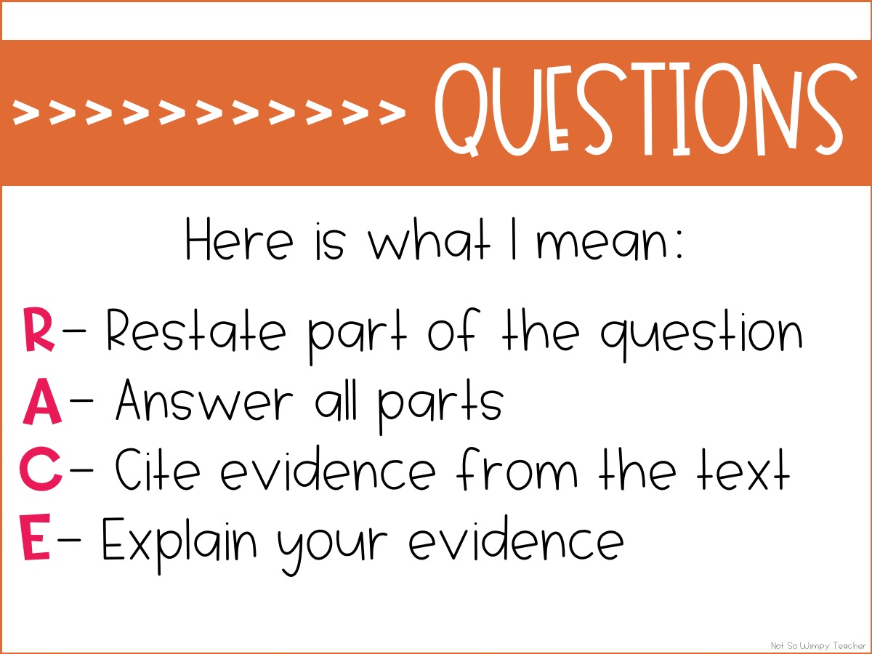

Slide 3
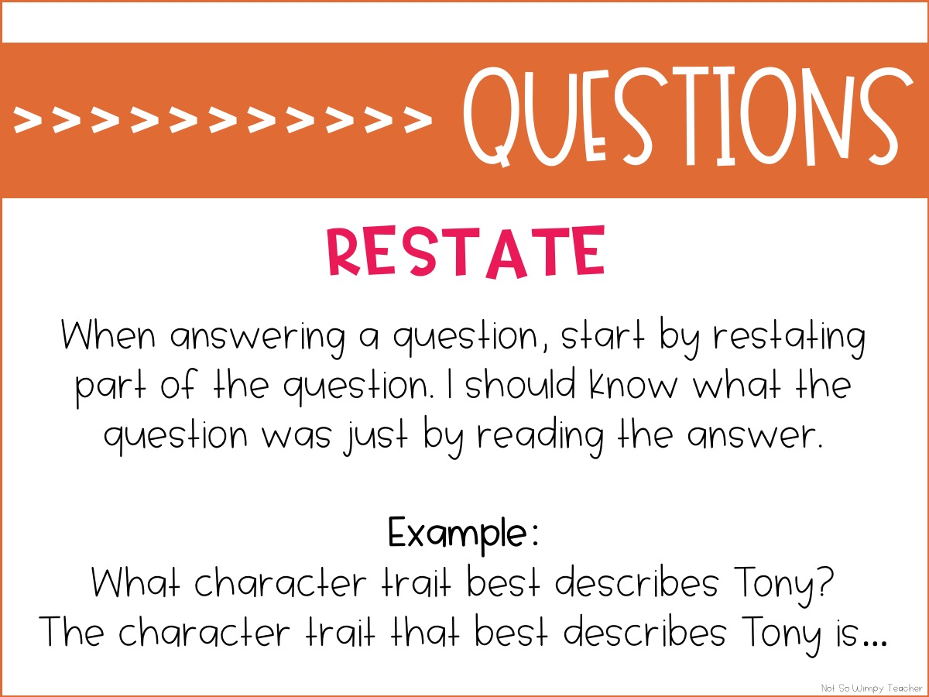

Slide 4
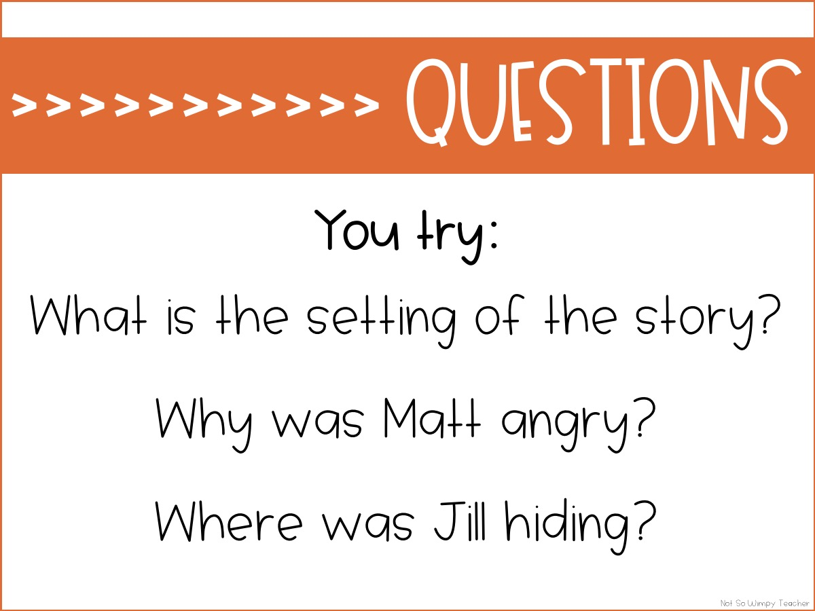

Slide 5
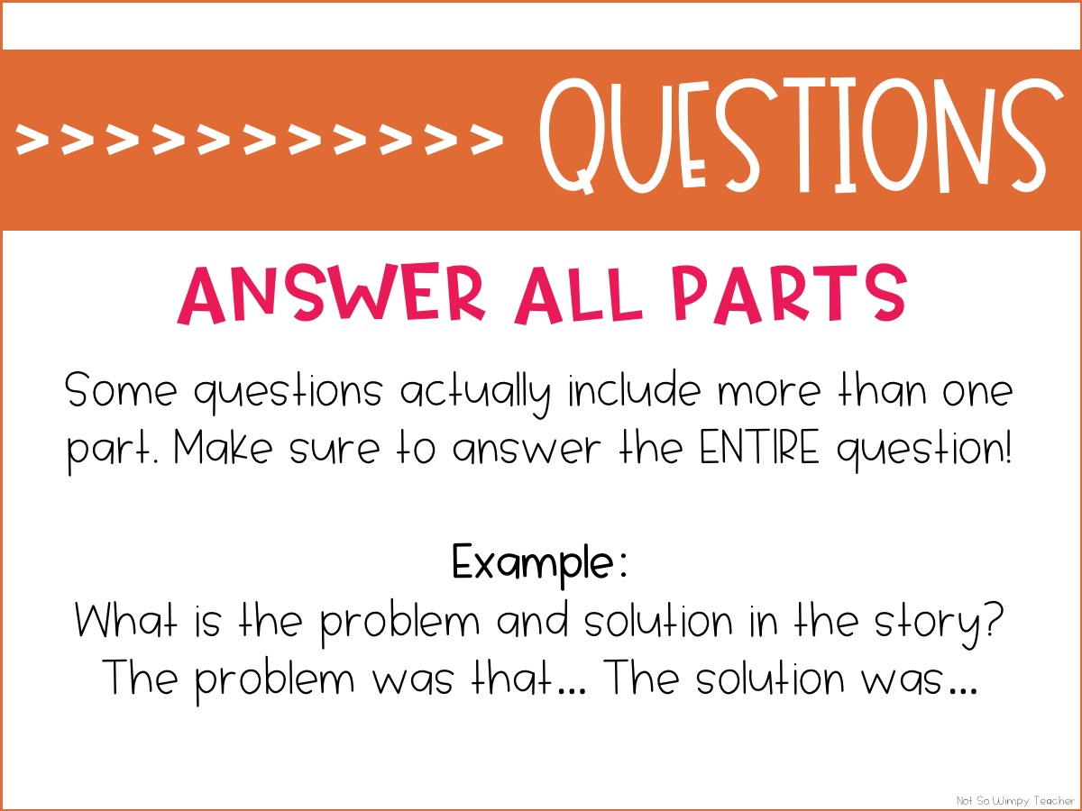

Slide 6
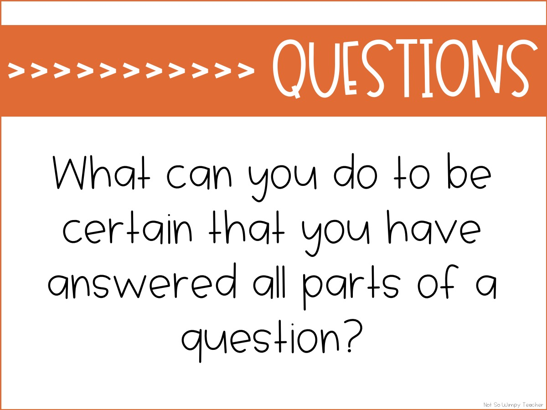

Slide 7
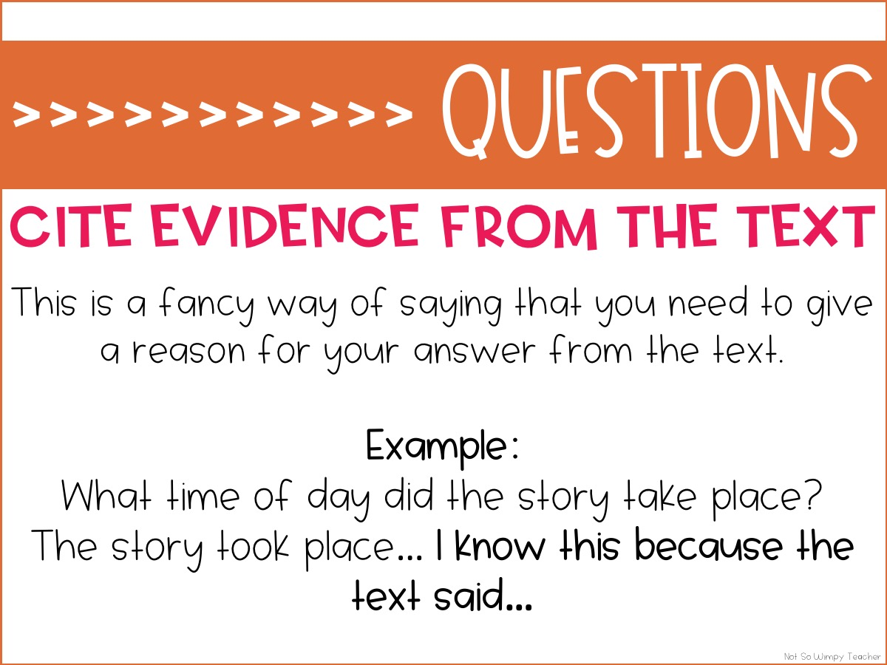

Slide 8
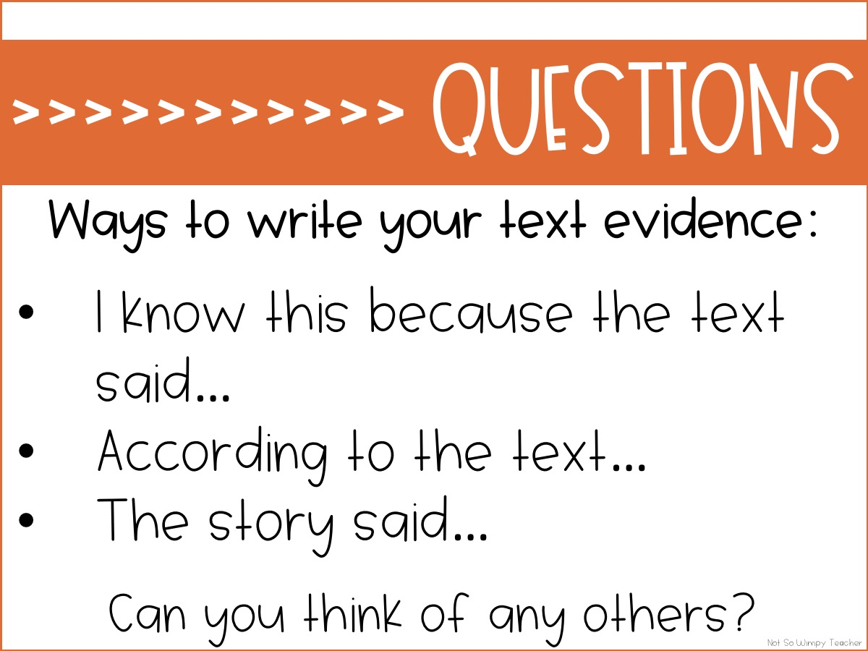

Slide 9
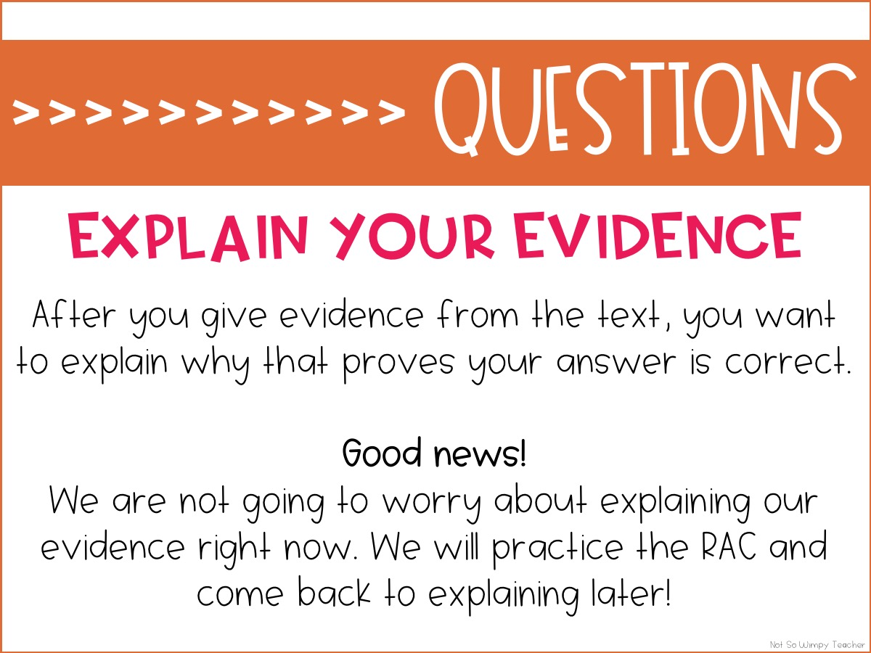
The Not So Wimpy Teacher strikes again!

Slide 10

The Not So Wimpy Teacher strikes again!

Slide 11
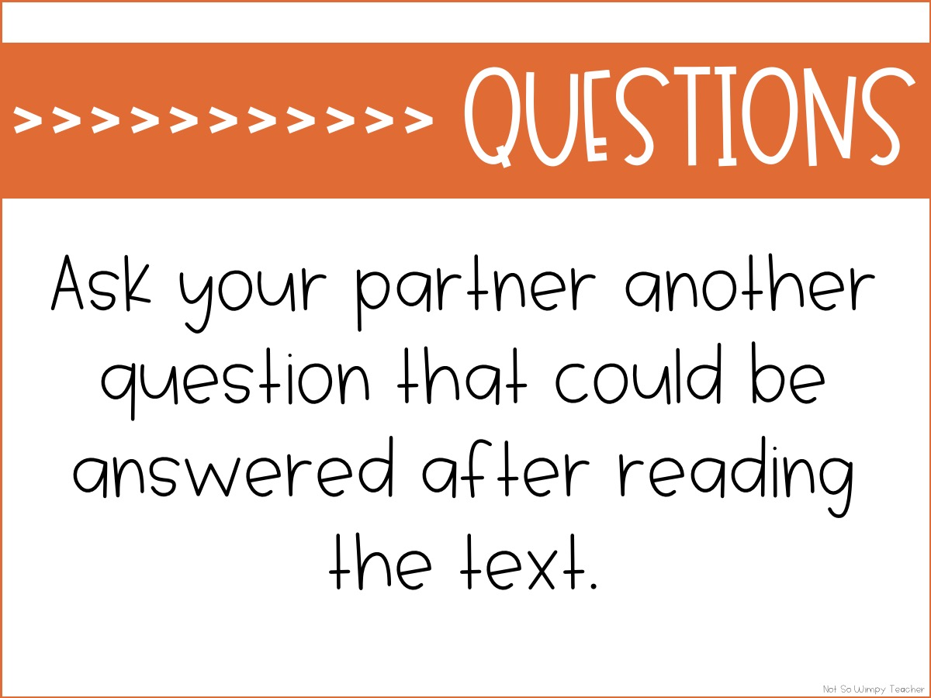
The Not So Wimpy Teacher strikes again!

Slide 12
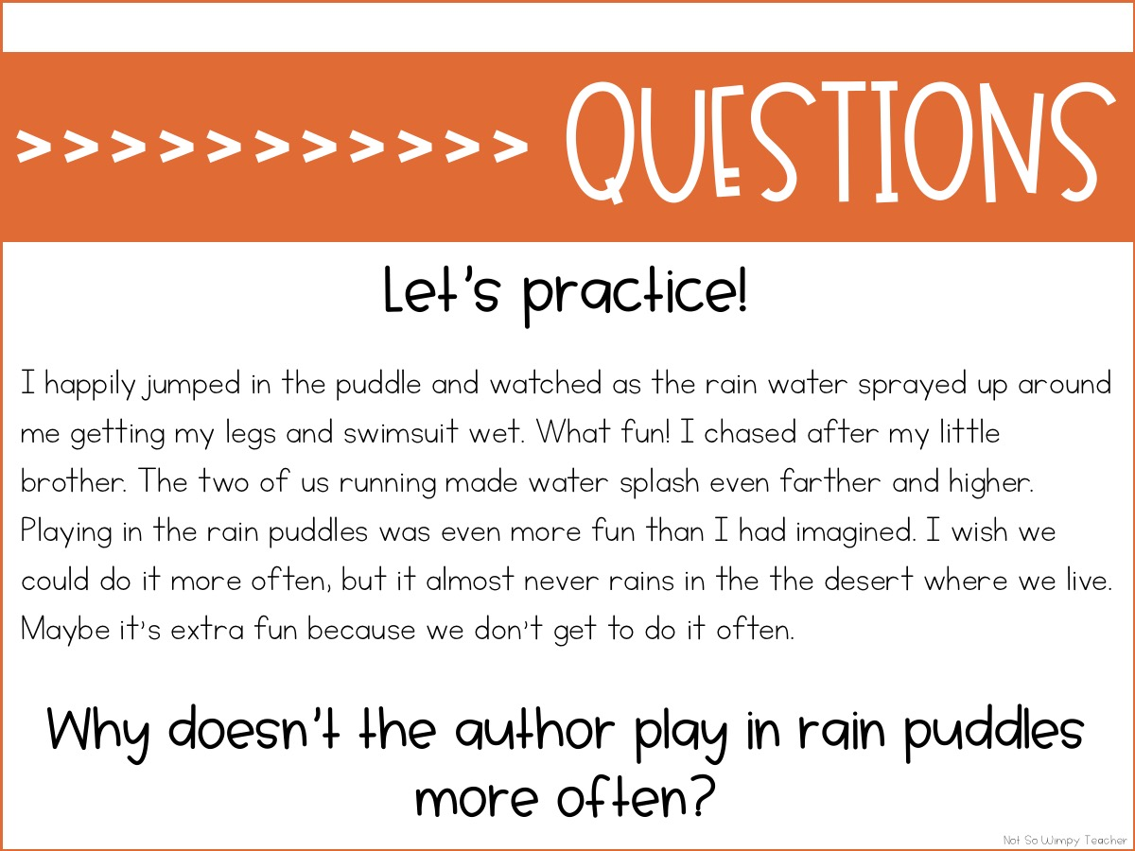
The Not So Wimpy Teacher strikes again!

Slide 13
The Not So Wimpy Teacher strikes again!

Slide 14
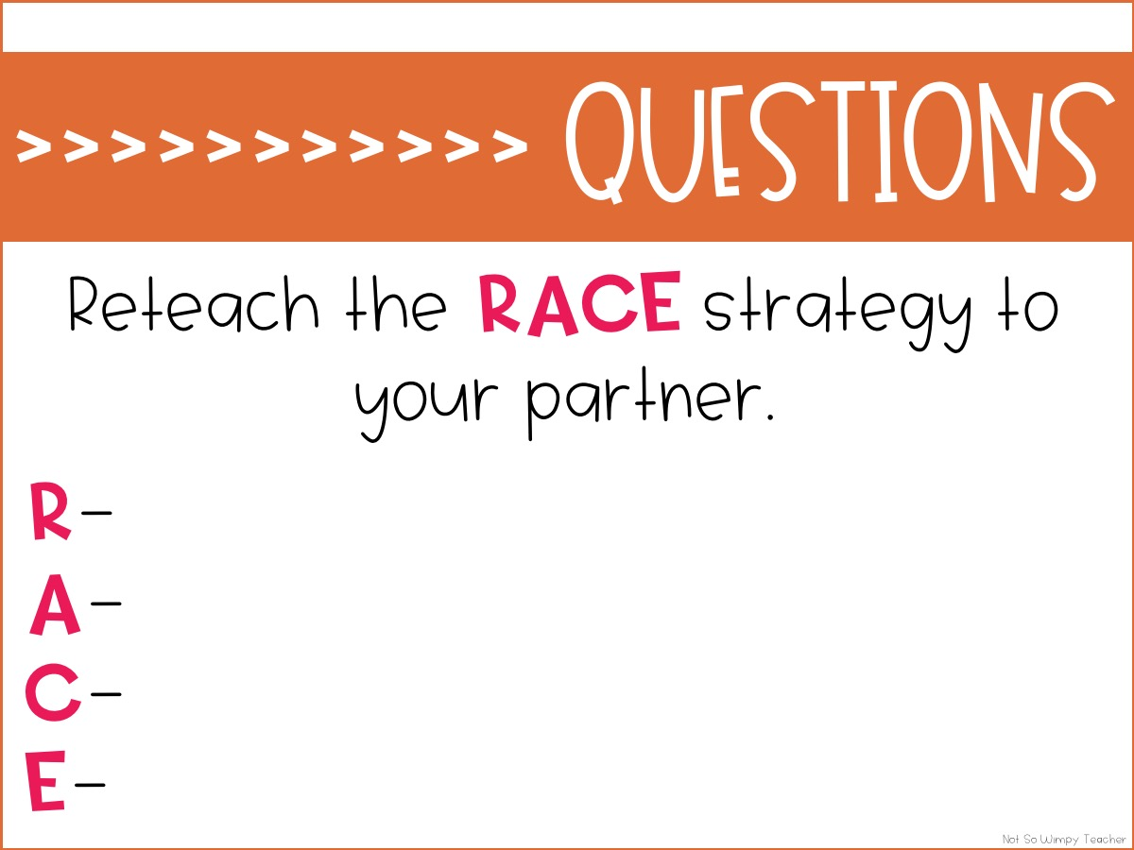
The Not So Wimpy Teacher strikes again!

