Slide 1
Tone and mood
OBJECTIVES:
What is Tone?
What is Mood?
How are Tone and Mood Effective in Writing?

Slide 2
WHAT IS MOOD?
Mood is the general atmosphere created by the author’s words.
It is the feeling the reader gets from reading those words.
It may be the same, or it may change from situation to situation.

Slide 3
Words That Describe Mood
Fanciful Melancholy Frightening Mysterious Frustrating Romantic Gloomy Sentimental Happy Sorrowful Joyful Suspenseful

Slide 4
Watch this movie trailer
http://www.youtube.com/watch?v=_hGhtmzTOEE&feature=related
Watching film evokes certain emotions and feelings from the viewer with the images, music, dialogue, etc. In the same way, writing evokes responses from the reader with the choice of words and writing style.
The tone and mood of your writing is determined by the words you use, and your writing style.

Slide 5
What is the Mood?
In the next six slides, try to guess the mood that the image creates.

Slide 6
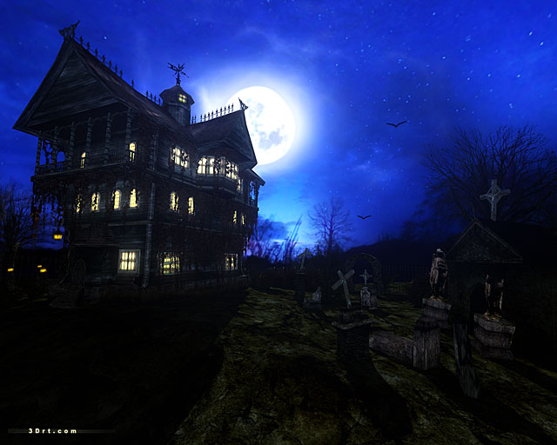
MOOD/Frightening

Slide 7
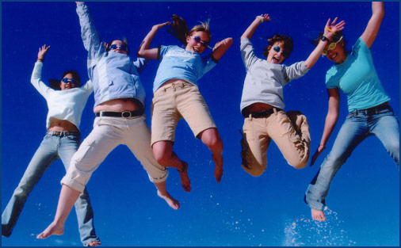
MOOD/Fun

Slide 8
MOOD/Happy

Slide 9
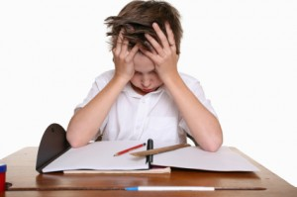
MOOD/Frustrated

Slide 10
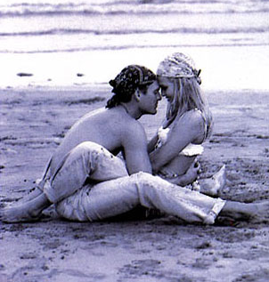
MOOD/ROMANTIC

Slide 11
MOOD/Melancholy

Slide 12
Tone and Mood
Watch out! Tone and mood are similar!
Tone is the author’s attitude toward the writing (his characters, the situation) and the readers.
A work of writing can have more than one tone.
An example of tone could be both serious and humorous.
Tone is set by the setting, choice of vocabulary and other details.

Slide 13
Reviewing Terms Main Idea, Tone, Mood, Setting
http://www.youtube.com/watch?v=xJAZ-RmArro&NR=1&feature=endscreen

Slide 14
What is the TONE?
Watch the video clip.
Choose 3 words to describe the tone.
http://www.youtube.com/watch?v=fuWf9fP-A-U

Slide 15
Watch it Again!
Now watch the same video images that are edited and with different music. Has the tone changed?
http://www.youtube.com/watch?v=2T5_0AGdFic

Slide 16
Video Clip: Tone and Mood Words
http://www.youtube.com/watch?v=jDUhDV-72S0

Slide 17
Words That Describe Tone
Amused Humorous Pessimistic Angry Informal Playful Cheerful Ironic Pompous Horror Light Sad Clear Matter-of-fact Serious Formal Resigned Suspicious Gloomy Optimistic Witty

Slide 18
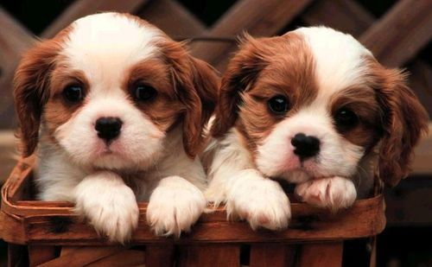

Slide 19
Tone? Mood?
Bouncing through the door, Alara lit up the room with a joyous glow on her face as she told her parents of her exam scores.

Slide 20
Bouncing through the door, Alara lit up the room with a joyous glow on her face as she told her parents of her exam scores.

Slide 21
Tone? Mood?
She huddled in the corner, clutching her tattered blanket and shaking convulsively, as she feverishly searched the room for the unknown dangers that awaited her.

Slide 22
She huddled in the corner, clutching her tattered blanket and shaking convulsively, as she feverishly searched the room for the unknown dangers that awaited her.

Slide 23
Tone? Mood?
Bursting through the door, the flustered mother screamed uncontrollably at the innocent teacher who gave her child an F.

Slide 24
Bursting through the door, the flustered mother screamed uncontrollably at the innocent teacher who gave her child an F.

Slide 25
Tone? Mood?
He cautiously glanced back as he heard his relentless pursuers, then hurriedly walked on, jumping at the slightest sound of a leaf crackling under his own foot.

Slide 26
He cautiously glanced back as he heard his relentless pursuers, then hurriedly walked on, jumping at the slightest sound of a leaf crackling under his own foot.

Slide 27
Gently smiling, the mother tenderly tucked the covers up around the child’s neck, and carefully, quietly, left the room making sure to leave a comforting ray of light shining through the opened door should the child wake.

Slide 28
Gently smiling, the mother tenderly tucked the covers up around the child’s neck, and carefully, quietly, left the room making sure to leave a comforting ray of light shining through the opened door should the child wake.

Slide 29
Tone? Mood?
The laughing wind skipped through the village, teasing trees until they danced with anger and cajoling the grass into fighting itself, blade slapping blade, as the silly dog with golfball eyes and flopping, slobbery tongue bounded across the lawn.

Slide 30
The laughing wind skipped through the village, teasing trees until they danced with anger and cajoling the grass into fighting itself, blade slapping blade, as the silly dog with golfball eyes and flopping, slobbery tongue bounded across the lawn.

Slide 31
The Crocodile
http://www.youtube.com/watch?v=PN8PfuyowG0

Slide 32
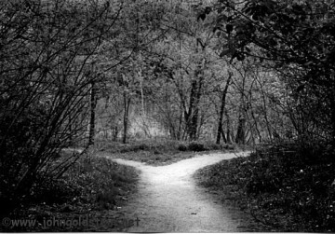
The Road Not Taken
Two roads diverged in a yellow wood, And sorry I could not travel both And be one traveler, long I stood And looked down one as far as I could To where it bent in the undergrowth; Then took the other, as just as fair, And having perhaps the better claim Because it was grassy and wanted wear, Though as for that the passing there Had worn them really about the same, And both that morning equally lay In leaves no step had trodden black. Oh, I marked the first for another day! Yet knowing how way leads on to way I doubted if I should ever come back. I shall be telling this with a sigh Somewhere ages and ages hence: Two roads diverged in a wood, and I, I took the one less traveled by, And that has made all the difference.

Slide 33
The Road Not Taken
Two roads diverged in a yellow wood, And sorry I could not travel both And be one traveler, long I stood And looked down one as far as I could To where it bent in the undergrowth; Then took the other, as just as fair, And having perhaps the better claim Because it was grassy and wanted wear, Though as for that the passing there Had worn them really about the same, And both that morning equally lay In leaves no step had trodden black. Oh, I marked the first for another day! Yet knowing how way leads on to way I doubted if I should ever come back. I shall be telling this with a sigh Somewhere ages and ages hence: Two roads diverged in a wood, and I, I took the one less traveled by, And that has made all the difference.

Slide 34
Use your Thesaurus
http://www.youtube.com/watch?v=OM8M0lcGqoQ&feature=endscreen&NR=1

