Slide 1

Elements of a Story
Elementsof a Story
Lauren Copus
Central Michigan University
11-12:15 EDU 290
Lauren Copus
Central Michigan University
EDU 290 11-12:15

Slide 2
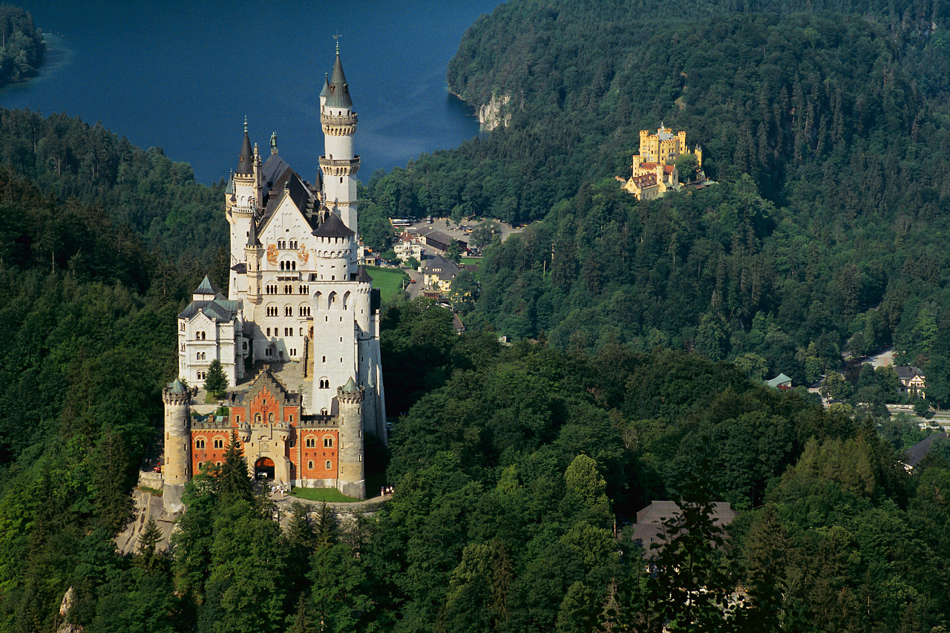
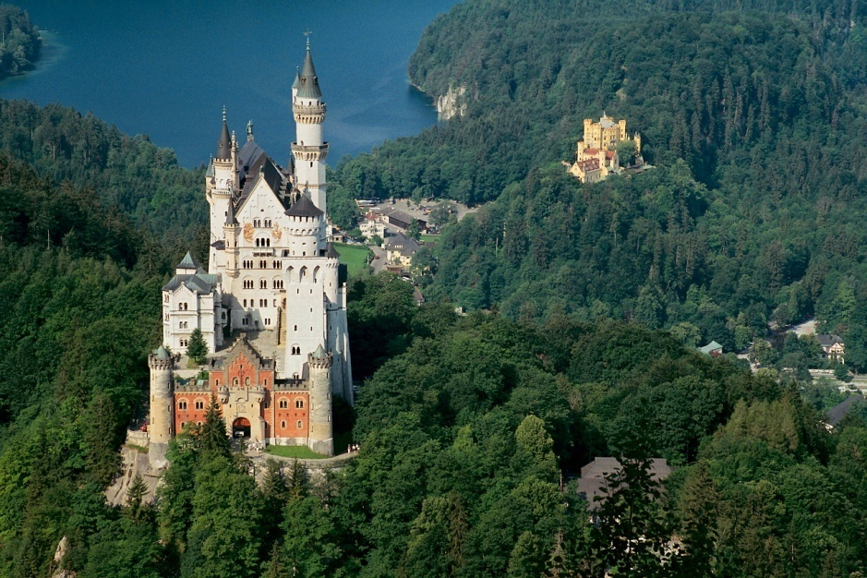
Setting – Where?
When we think about the setting of a story we need to find out WHERE the story takes place.
In the story Cinderella, the story takes place in a castle.
The first part of the setting of the story is WHERE does the story take place?
The setting also includes WHEN the story takes place.
Is the story in the past, present or future?

Slide 3

Setting – When?
When we think about the setting of a story we also need to find out when the story takes place.
Is the story set in the past? The present? The future?

Slide 4
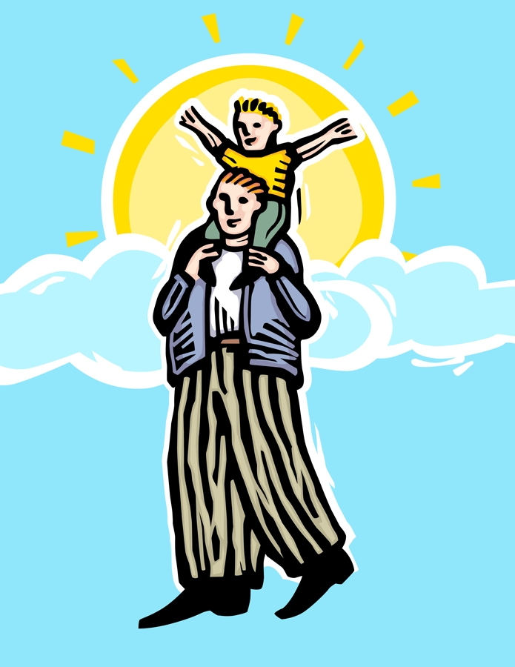
CHARACTERS
When we read or write a story, we also need to think about the people in the story.
These people in the story are our characters.

Slide 5
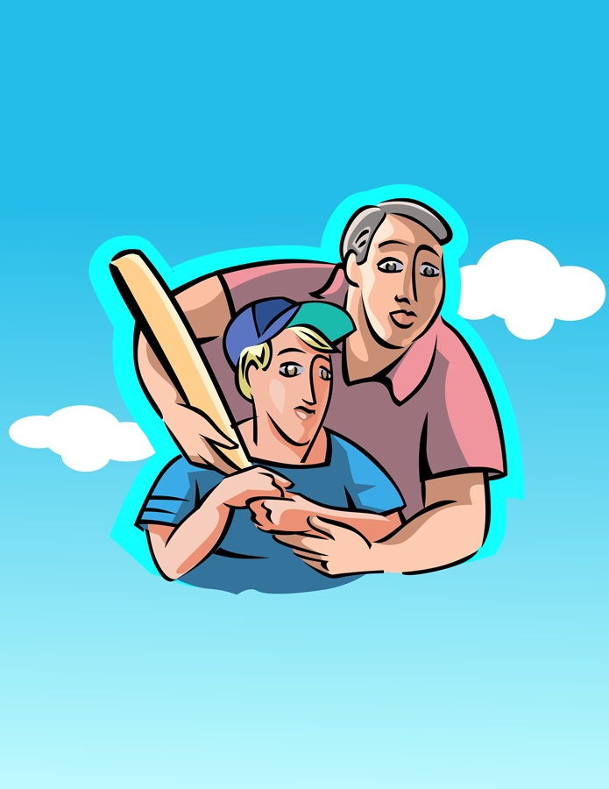
Characters
We can use describing words to tell what we know about them.
We can say if they are kind, funny, mean, tall, or short.

Slide 6

Sequence
Every story has a series of events which is also called a sequence of events.
These events in a specific order make up the plot of the story.
All of the action in a story is called the PLOT.

Slide 7
Plot Line Diagram
Climax
Rising Action
Falling Action
Resolution
Exposition

Slide 8
Exposition
The exposition of a story tells about the events that happened before the story.
It gives us background information on the setting and characters.
This is the first part of our plot line.

Slide 9
Action
Rising Action
Falling Action
Rising action is the action that occurs before the climax.
The falling action is the events that occur after the climax and lead to the resolution

Slide 10

Conflict
Conflict is the part of the story where the characters are faced with a problem.

Slide 11
Climax
The climax of the story is when the conflict between characters is resolved.
It is the most exciting part of the story.
The climax is the very top of our plot line.

Slide 12

Resolution
The resolution of the story is after the climax.
This is when we find out what happens after the conflict is resolved between characters.

Slide 13
Resources
photo &copy; Sarah Klockars-Clauser for <A HREF=http://22455.openphoto.net>openphoto.net</A> CC:Attribution
“Interactives: Elements of a Story,” < http://www.learner.org/interactives/story/about.html#n4>.
Plot Line Graphic, slides 7, 8, 9, 11. Lauren Copus

